Slide 1
Evaluating LoRaWAN performance in intentional and unintentional DoS attacks by legacy 900MHz network devices
Team 454P
Seokhyeon Bang
Junyoung Jang
Doyong Kwon
Yuseon Choi
Minju Ro
Jerry Lee
2022 K-SW square final-presentation
Notes:
Hello everyone, This is Yuseon Choi from team 454P. I’ll present the project background and problem statement.

Slide 2

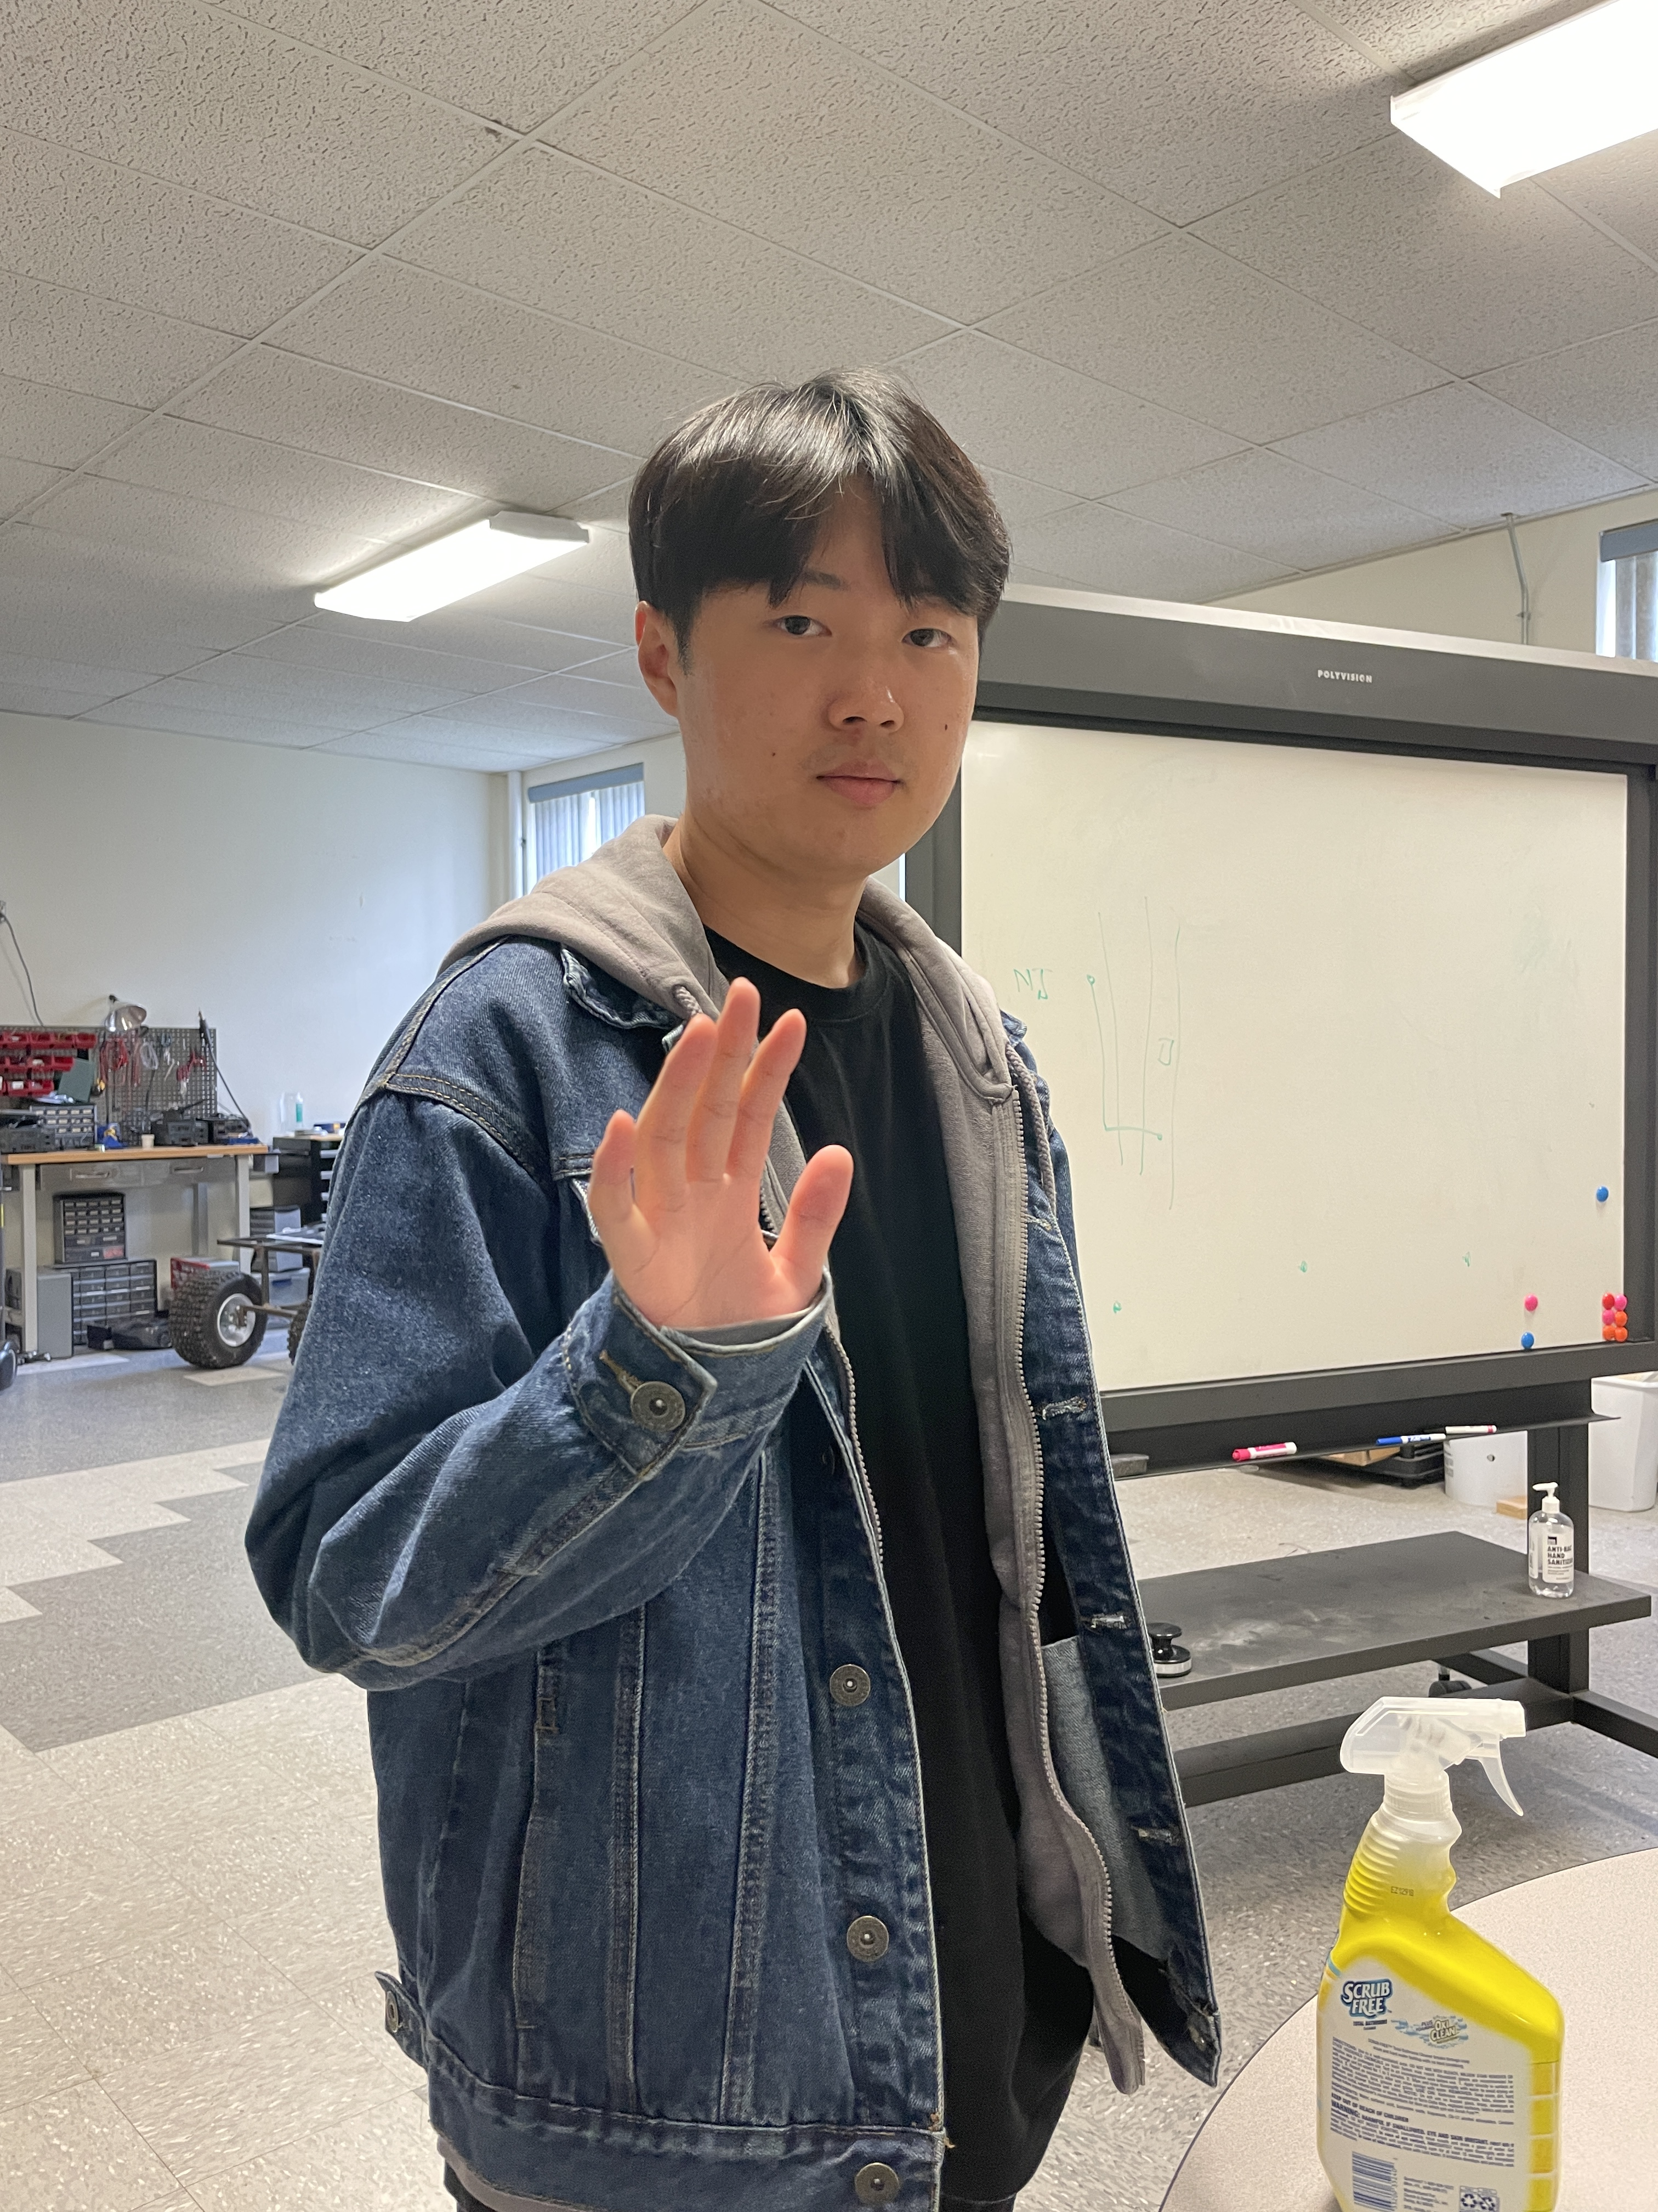




Team Members (454P)
Seokhyeon Bang (Team Leader)
Chung-Ang University
kzrt0123@cau.ac.kr
Doyong Kwon
Kyungpook National University
doyong365@knu.ac.kr
Junyoung Jang
Chung-Ang University
junjang99@cau.ac.kr
Minju Ro
Chung-Ang University
romj98@cau.ac.kr
Yuseon Choi
Chonnam National University
181133@jnu.ac.kr
Jerry Lee
Purdue University
lee3245@purdue.edu
Notes:
Hello everyone, This is Yuseon Choi from team 454P. I’ll present the project background and problem statement.

Slide 3
Contents
1. Background
Introduction
Use Cases of LoRaWAN
2. Problem Statement
Security issues of LoRaWAN
Goal of 454P
3. Experiment Architecture
Experiment Devices
Experiment Purpose and Architecture
Indoor / Outdoor Experiment
4. Experiment Outcome
5. Conclusion
3
Notes:
Hello everyone, This is Yuseon Choi from team 454P. I’ll present the project background and problem statement.

Slide 4

Background

Slide 5
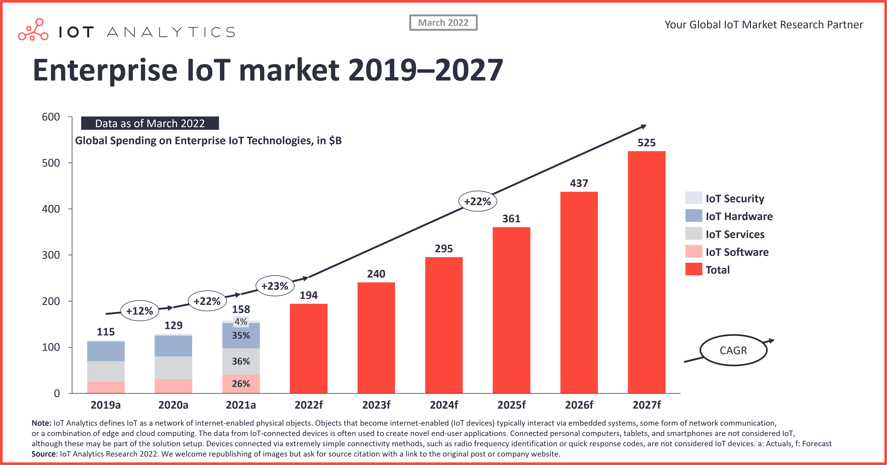
Introduction
Figure 1: Global IoT market growth [1]
Notes:
With the development of AI and networking technology, the IoT market is gradually growing and the supply of IoT devices is expanding.

Slide 6
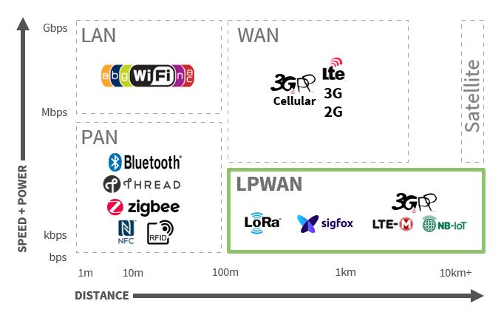
Introduction
Figure 2: Wireless Technologies in IoT [2]
Notes:
IoT wireless communication technology is classified according to distance, speed, and power as slide in the screen.
Compared to other wireless communication technologies, LPWAN is specialized for transmitting small data in far distance. So it is widely applied in the IoT field.

Slide 7
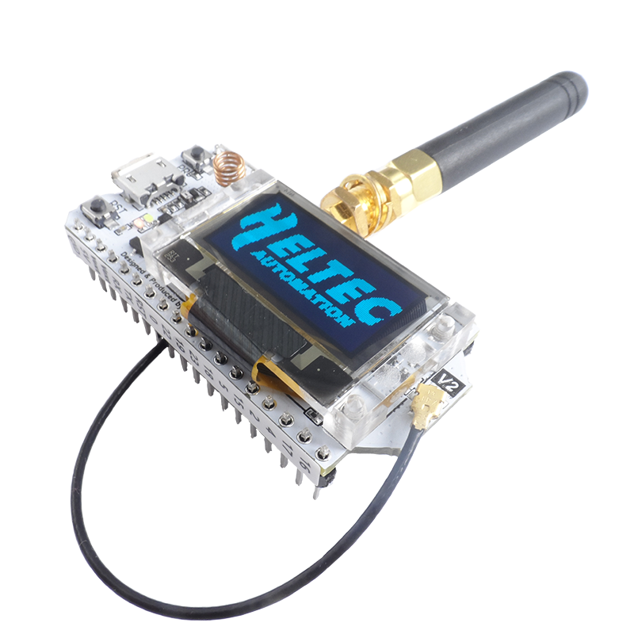
Use cases of LoRaWAN
Advantages of LoRaWAN
Compared to other LPWAN Technologies
Long-Distance (Coverage)
Low-Power (Battery Life)
Cost Effective
Data Rate
Figure 3: Wi-Fi LoRa 32 [3]
Notes:
But LoRa which is available in the unlicensed frequency band is more efficient than others.

Slide 8
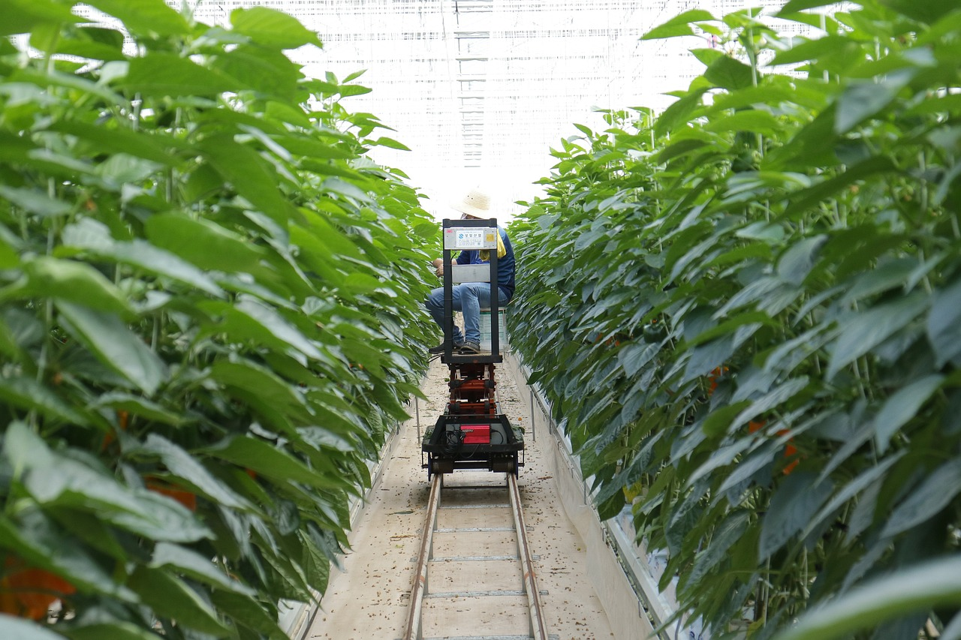
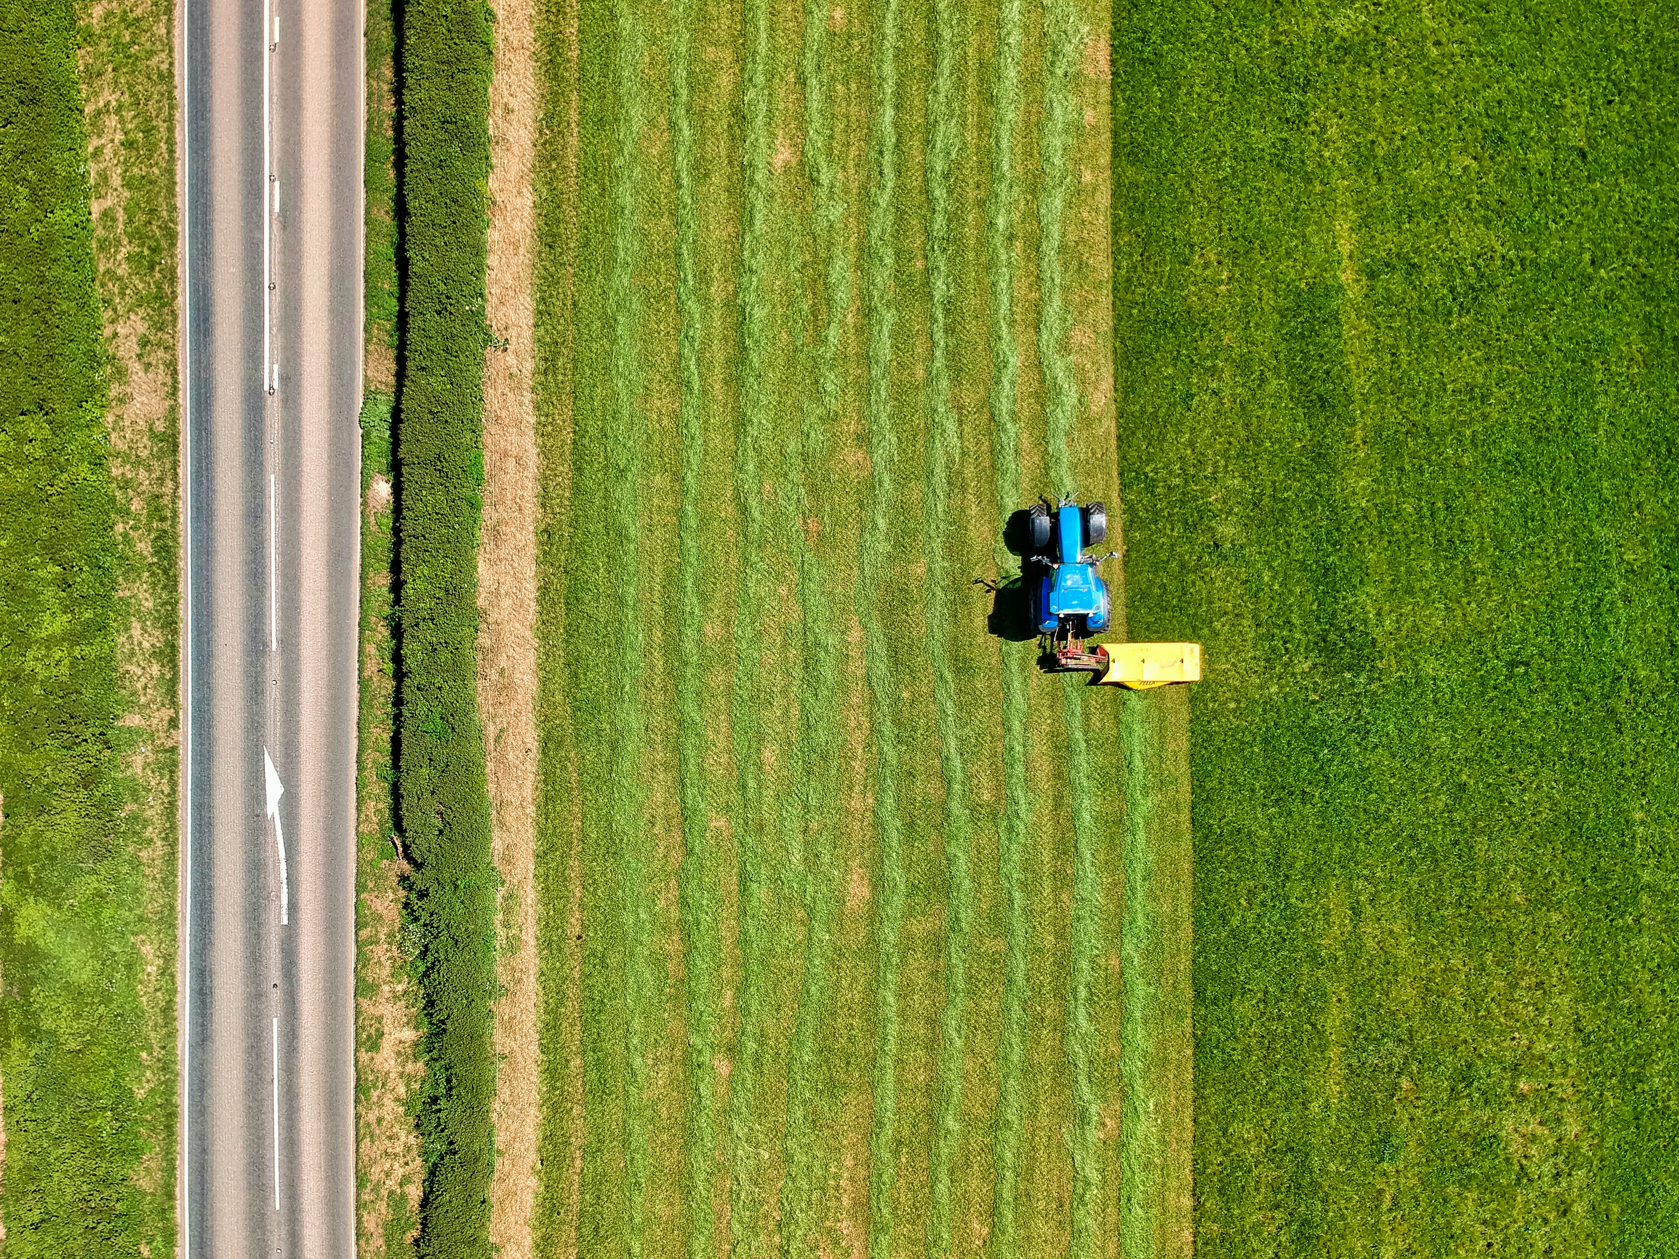
Use cases of LoRaWAN
Agriculture Field
Used in smart farms to increase production by monitoring information
Wide areas require wireless connectivity and long lasting battery
➡ LoRaWAN enables low-power, long-distance communication
Notes:
For example, LoRaWAN is used in smart farms to increase production by monitoring information such as soil nutrients or moisture levels in real time. In the agricultural industry, wide areas require affordable wireless connectivity, but the size of the farm is too far to replace the battery of the sensor often, so long lasting battery on the end device is an important factor. LoRaWAN is suitable solution to this problem. LoRaWAN enables low-power, long-distance communication and agricultural automation by connecting widely distributed sensors.

Slide 9
Use cases of LoRaWAN
Agriculture Field
Compared to other LPWAN Technologies
Long-Distance (Coverage)
Low-Power (Battery Life)
Cost Effective
Data Rate
Notes:
For example, LoRaWAN is used in smart farms to increase production by monitoring information such as soil nutrients or moisture levels in real time. In the agricultural industry, wide areas require affordable wireless connectivity, but the size of the farm is too far to replace the battery of the sensor often, so long lasting battery on the end device is an important factor. LoRaWAN is suitable solution to this problem. LoRaWAN enables low-power, long-distance communication and agricultural automation by connecting widely distributed sensors.

Slide 10
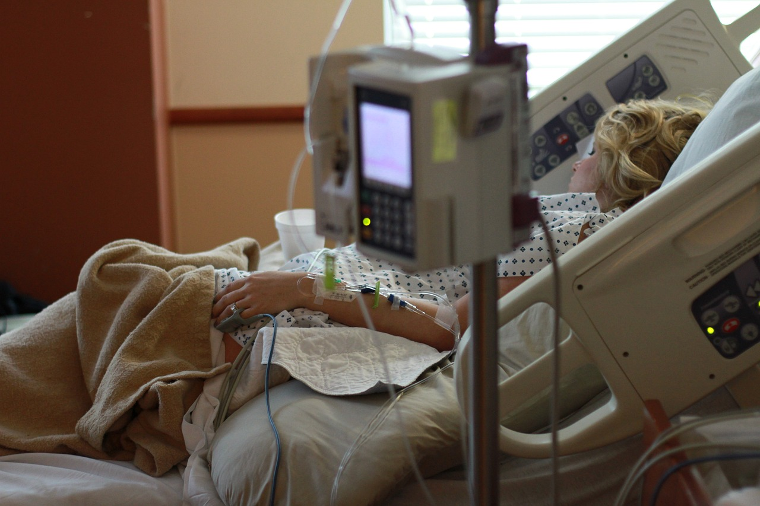
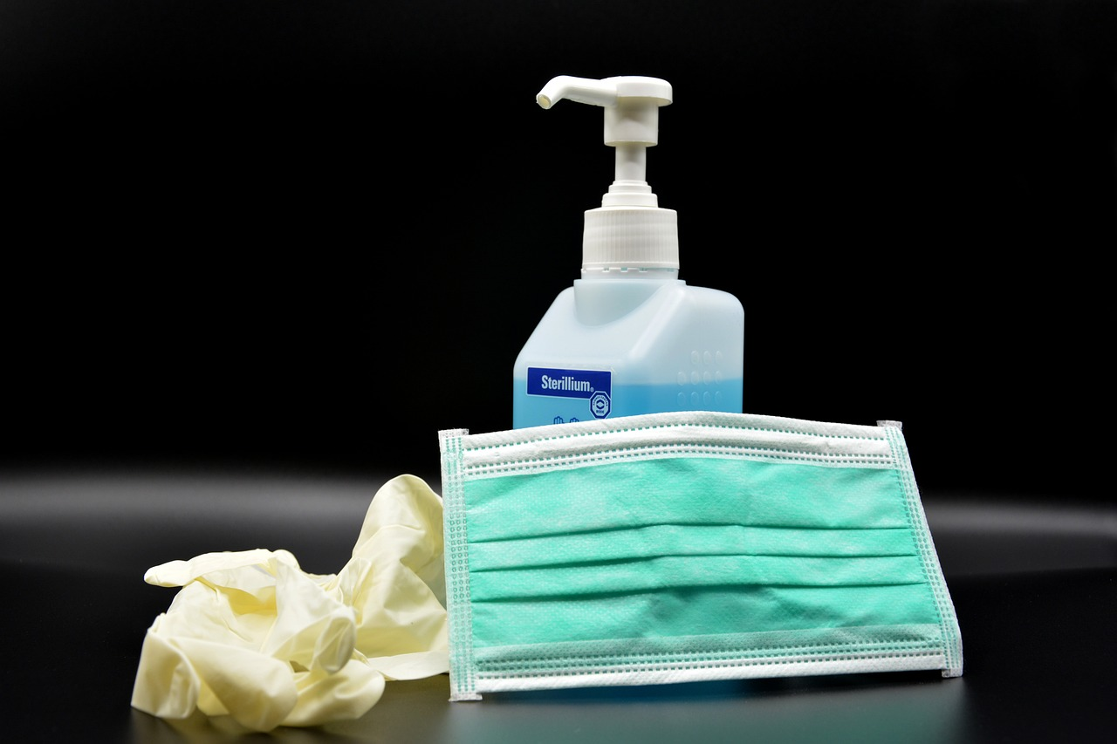
Use cases of LoRaWAN
Medical Field
Used in monitoring patients or responding flexibly to emergencies
Medical areas require remote communication and low operating costs
➡ LoRaWAN enables cost effective communication with high data rate
Notes:
Another example is that LoRaWAN is used in medical field such as overseeing the transfer of critical patients to the ward by tracking their location or monitoring health data between nearby cities to prevent the spread of infection. By using LoRaWAN, it is possible to rapidly respond emergencies occurred in medical field. Also, it can communicate remotely with users in rural area and the cost of installation and operation is relatively low than cellular communication links.

Slide 11
Use cases of LoRaWAN
Medical Field
Compared to other LPWAN Technologies
Long-Distance (Coverage)
Low-Power (Battery Life)
Cost Effective
Data Rate
Notes:
Another example is that LoRaWAN is used in medical field such as overseeing the transfer of critical patients to the ward by tracking their location or monitoring health data between nearby cities to prevent the spread of infection. By using LoRaWAN, it is possible to rapidly respond emergencies occurred in medical field. Also, it can communicate remotely with users in rural area and the cost of installation and operation is relatively low than cellular communication links.

Slide 12
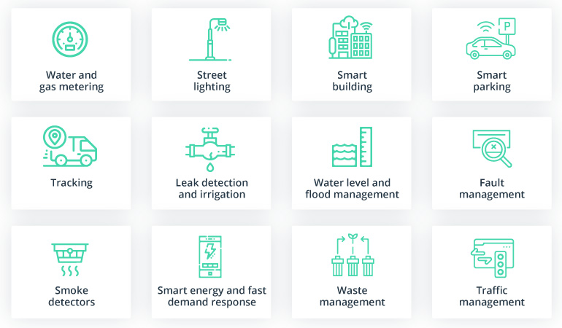
Use cases of LoRaWAN
Advantages of LoRaWAN
Compared to other LPWAN Technologies
Long-Distance (Coverage)
Low-Power (Battery Life)
Cost Effective
Data Rate
Figure 4: LoRaWAN use cases within a smart city [4]
Notes:
In summary, LoRaWAN has advantages in terms of coverage, battery life, cost effective, and data rate than other LPWAN technologies.
For these reasons, LoRaWAN becomes competitive in the IoT field and widely applied in various industries.

Slide 13
Problem Statement
Notes:
If information loss occurs in industries that use LoRa, the damage will be enormous.
But as you can see, global spending of IoT security records only 4%, which is relatively low compared to IoT services, hardware and software. Through these figures, we thought we needed to study the security of LoRaWAN, which is used in various IoT industries.

Slide 14
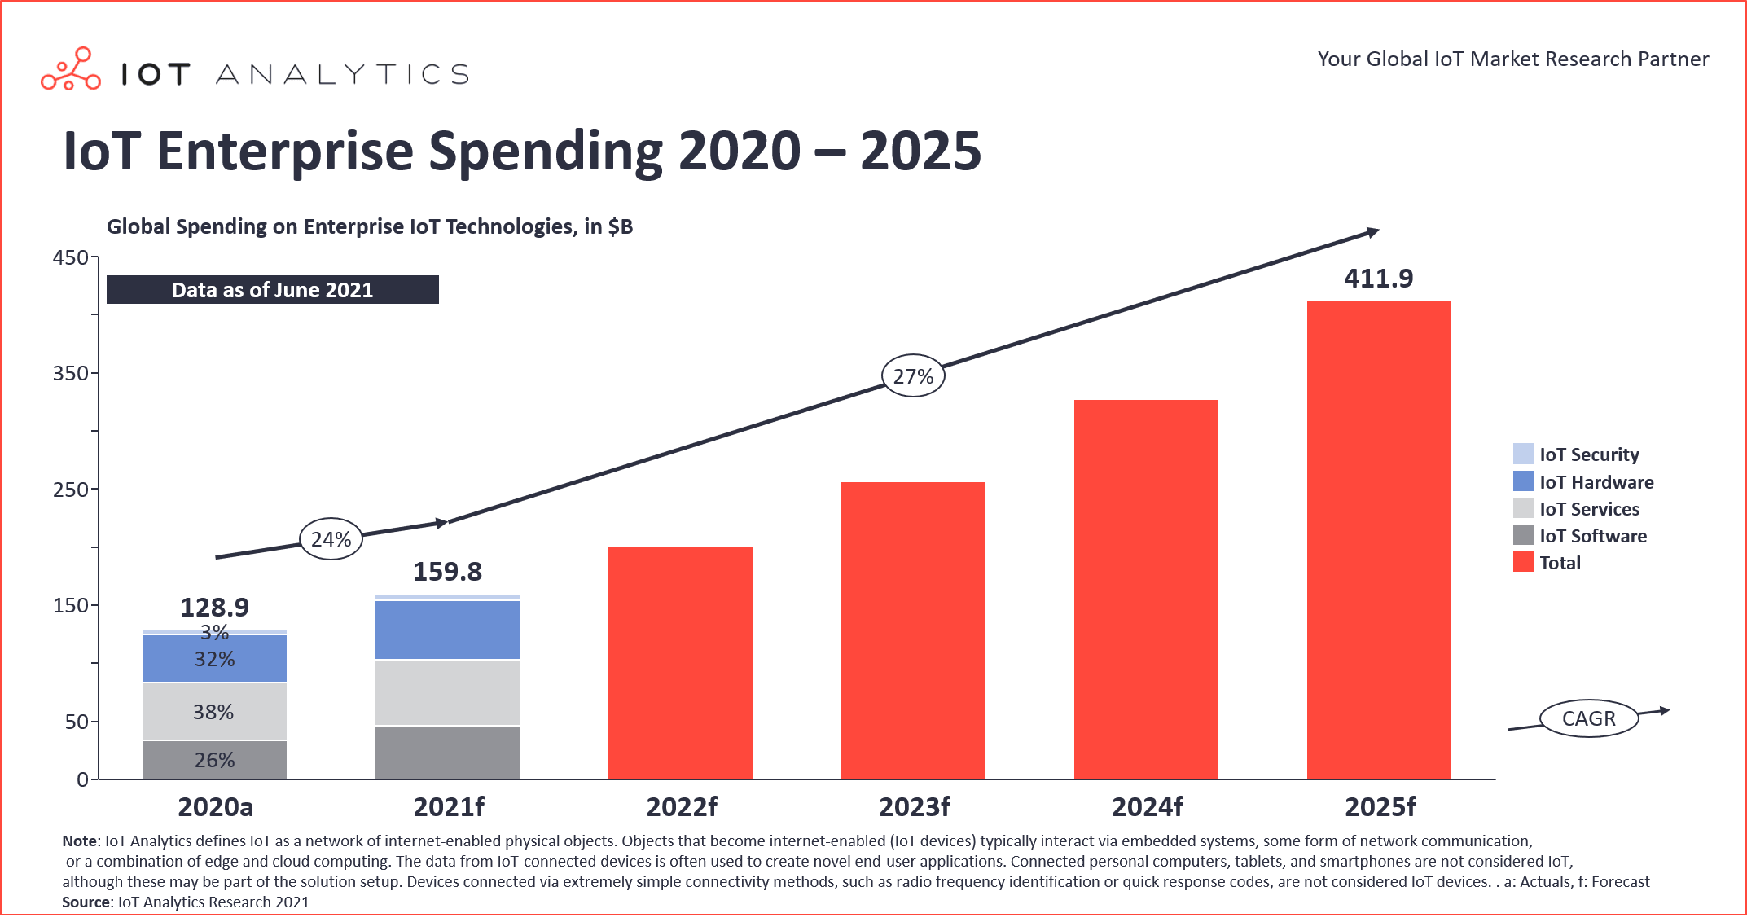
Security Issues of LoRaWAN
4%
Figure 5: Global Spending on Enterprise IoT Technologies [5]
Notes:
If information loss occurs in industries that use LoRa, the damage will be enormous.
But as you can see, global spending of IoT security records only 4%, which is relatively low compared to IoT services, hardware and software. Through these figures, we thought we needed to study the security of LoRaWAN, which is used in various IoT industries.

Slide 15
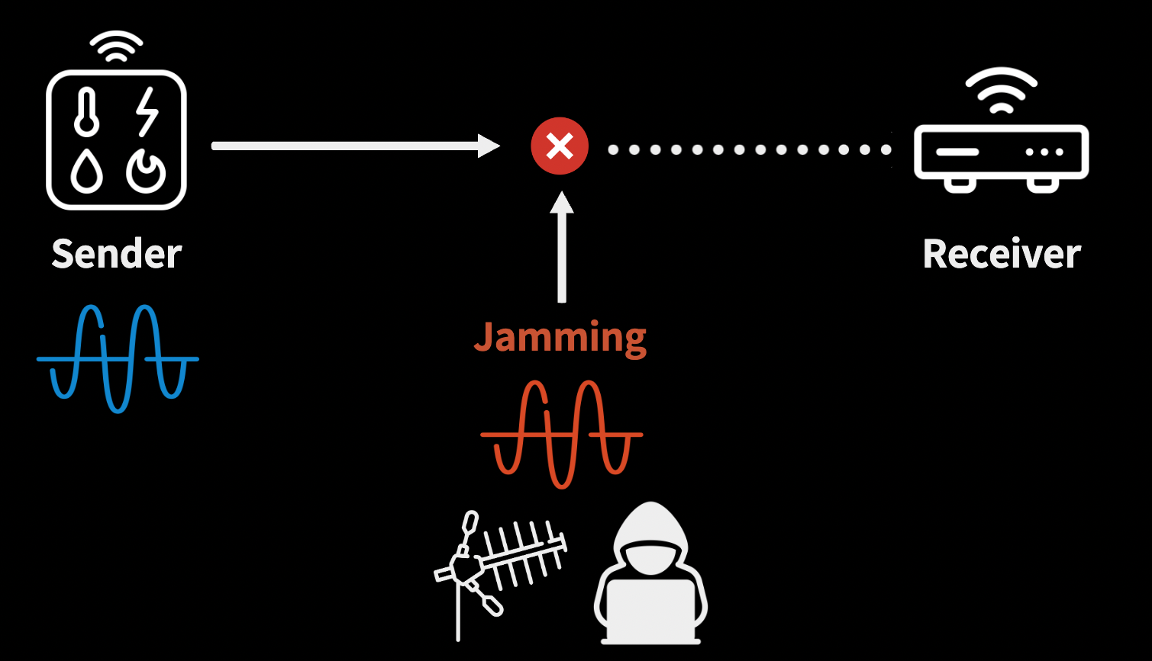
Security Issues of LoRaWAN
Possible Security Threats
Eavesdropping
Replay attack
ACK Spoofing
Bit-flipping attack
LoRa class B attack
Jamming
Easy to access and Cost effective!
Notes:
LoRaWAN has several security vulnerabilities, but the easiest and most effective attack is jamming. So What is jamming? Jamming is a technology that prevents the operation of specific frequencies by emitting Radio waves.

Slide 16
Security Issues of LoRaWAN
Why 454P chose Jamming as an attacking method?
LoRa is based on the Chirp Spread Spectrum
➡ Attackers are able to exploit the chirp frequency to disrupt communication
LoRaWAN operates in predetermined frequencies band
➡ This weakness makes LoRa more vulnerable to Wideband jamming attacks
Notes:
The reasons why we chose jamming are presented in this slide. LoRa is based on the Chirp Spread Spectrum so attackers are able to exploit the chirp frequency to disrupt communication. Also LoRaWAN operates in predetermined frequencies band. This weakness makes LoRa more vulnerable to Wideband jamming attacks. Information loss due to this weakness can cause human and property damage in high-risk industries.

Slide 17


Goal of 454P
Objective
Assess the network performance according to jamming by conducting experiment
Evaluate the performance of LoRaWAN against
intentional and unintentional Denial of Service (DoS) attacks
Indoor
Outdoor
Literature Review
Measure network performance in urban environments or tree farms
➡ Few cases have analyzed how jamming affects the network in real-world
Notes:
Therefore, this research aims to assess the network performance according to jamming by conducting an indoor experiment in a complex building to simulate the medical field /and an outdoor experiment to simulate environment in agriculture. There are several prior studies measuring network performance in urban environments or tree farms which have a lot of obstacles, but few cases have analyzed how jamming affects the network in real-world industrial sites. Our experiment concentrates in evaluating the performance of LoRaWAN against intentional and unintentional Denial-of-Service attacks by conducting two different experiments.

Slide 18
Experiment Architecture
Notes:
These experimental environments will be explained by Doyong.
Hello, my name is Doyong, and from now on, I will tell you about how we designed our experiments.

Slide 19
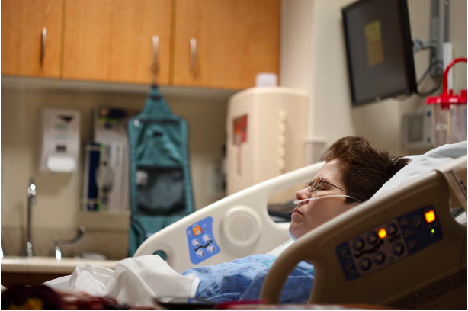
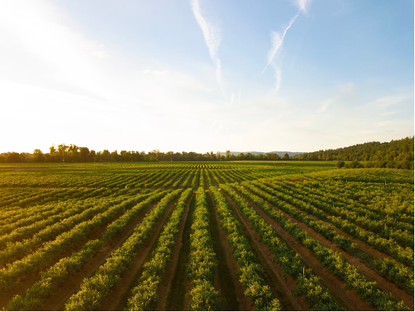
Experiment Environment
Medical Industry
Agricultural Industry
Indoor (Hospital)
Outdoor (Farm)
Notes:
Since we were able to confirm that the canopies can interfere with LoRaWAN, we set up indoor experiments and outdoor experiments to simulate the environment of medical industry like hospitals and agricultural industry like farms.

Slide 20
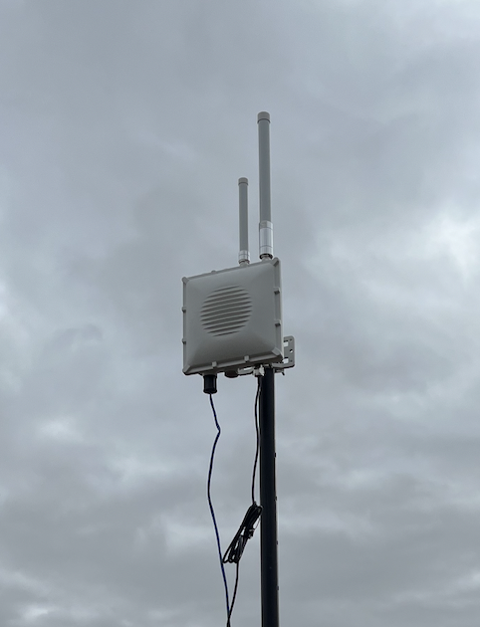
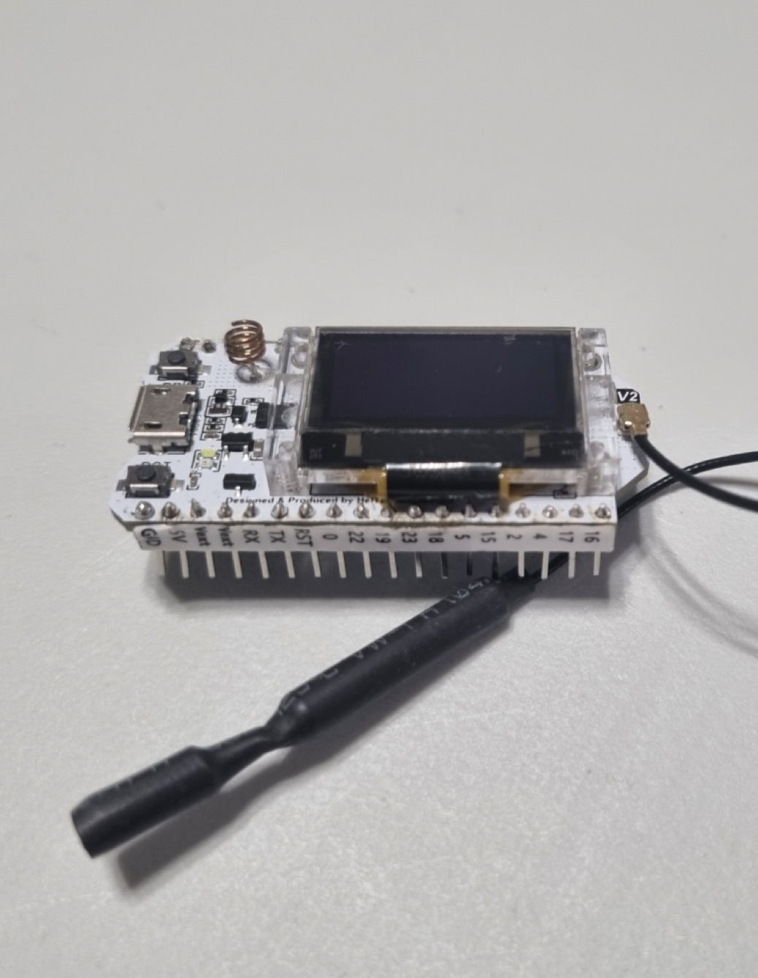
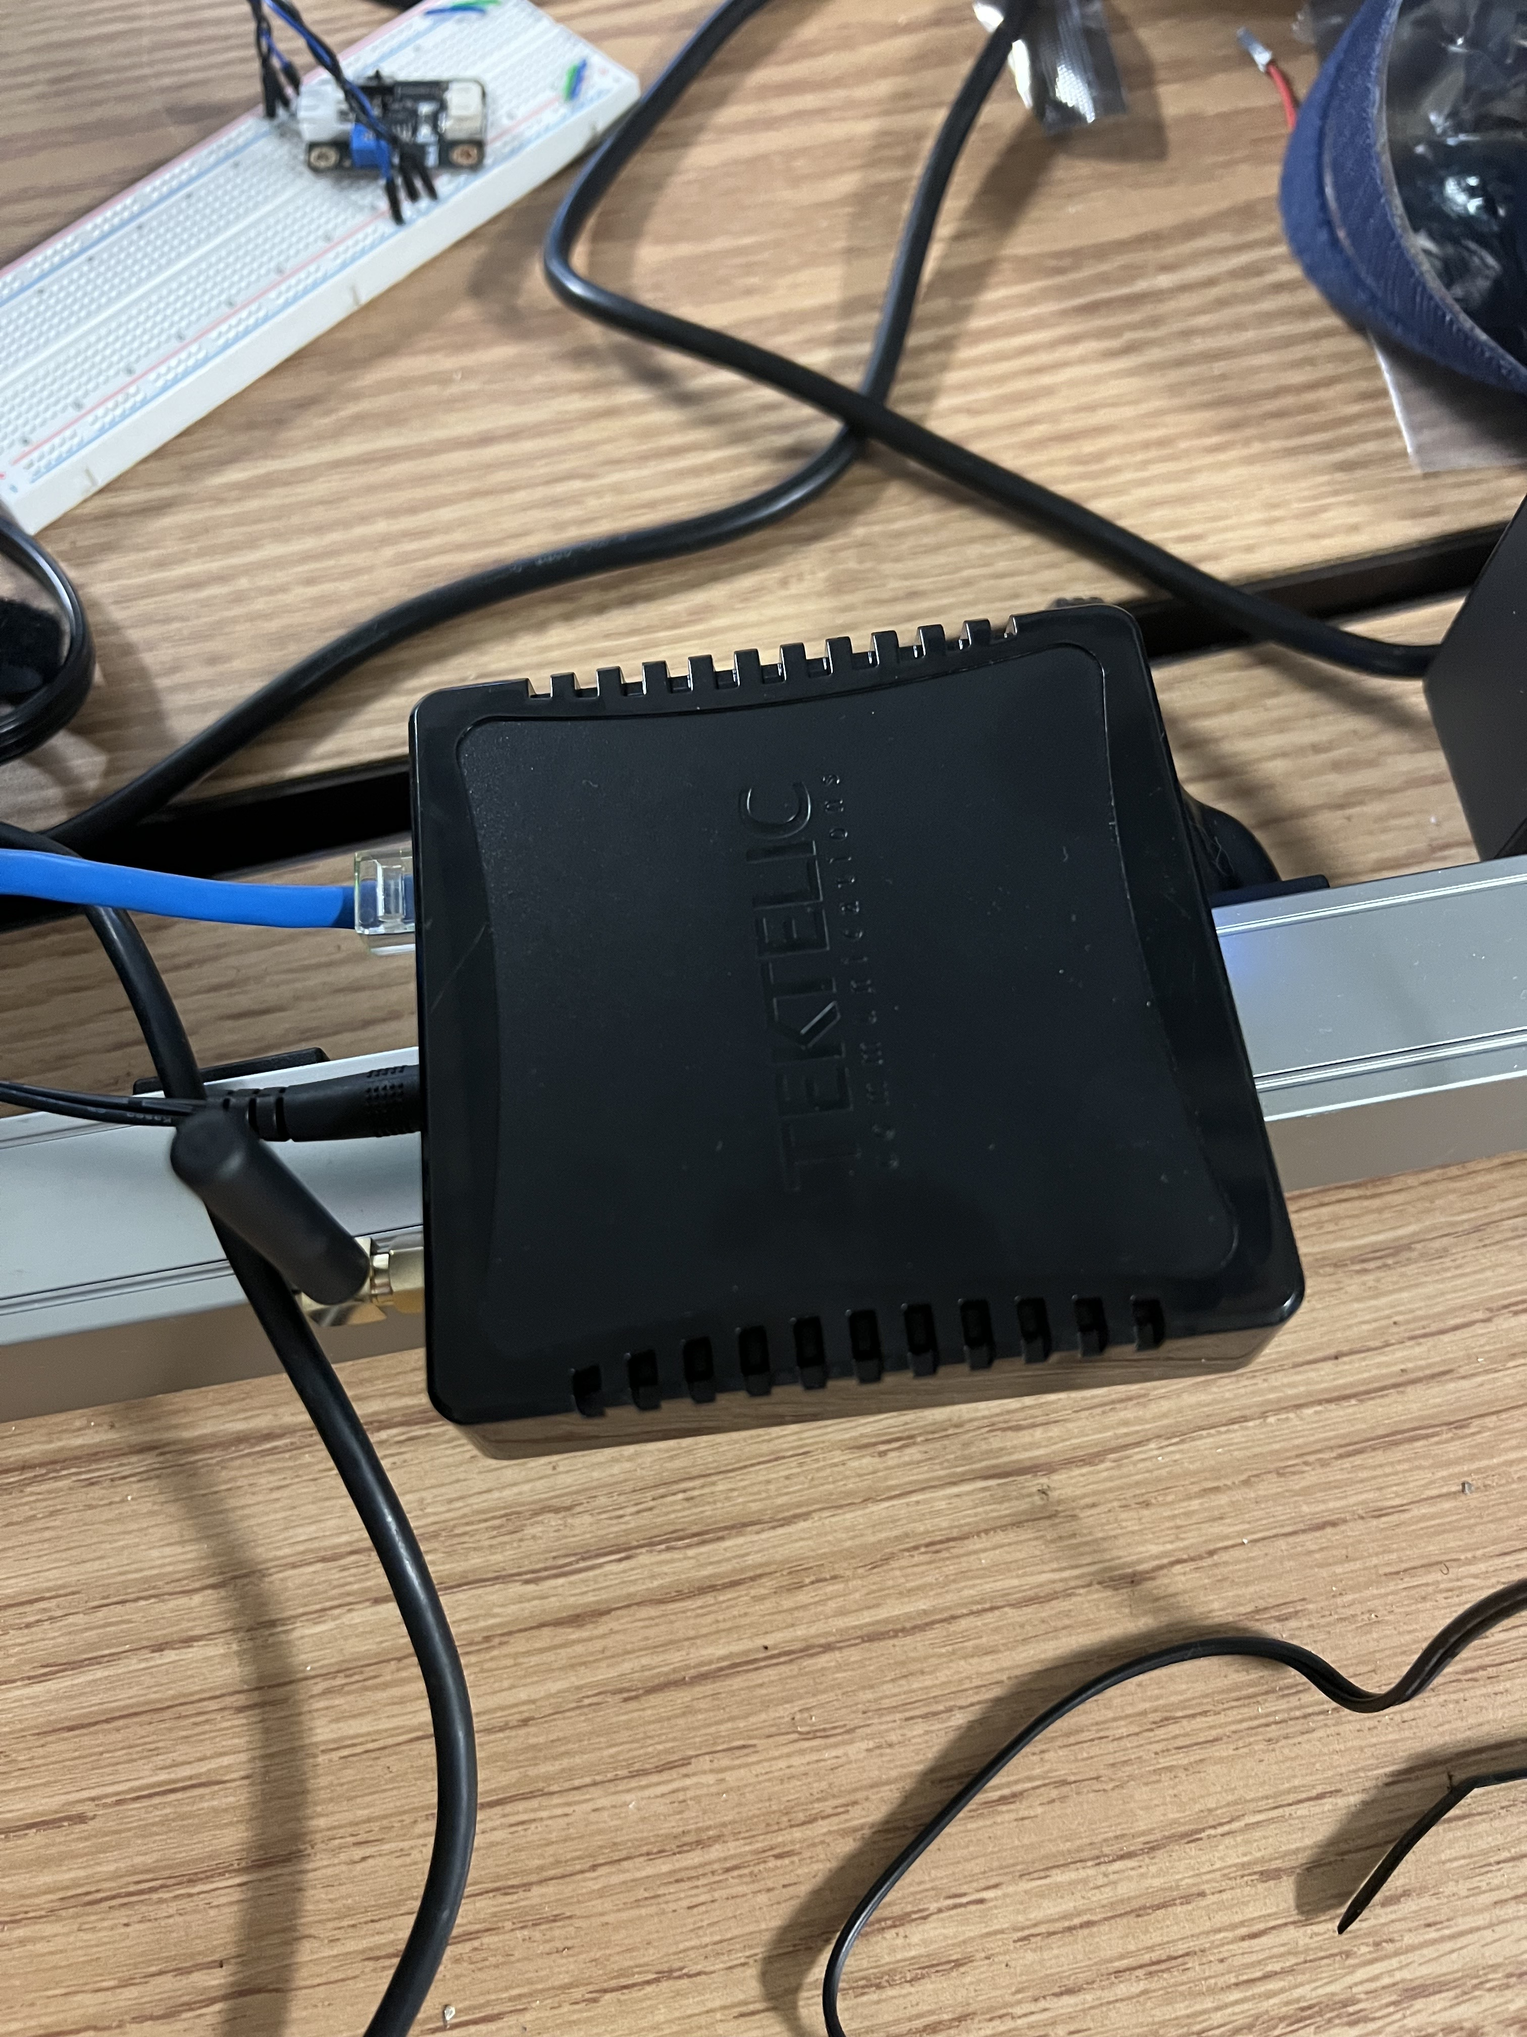
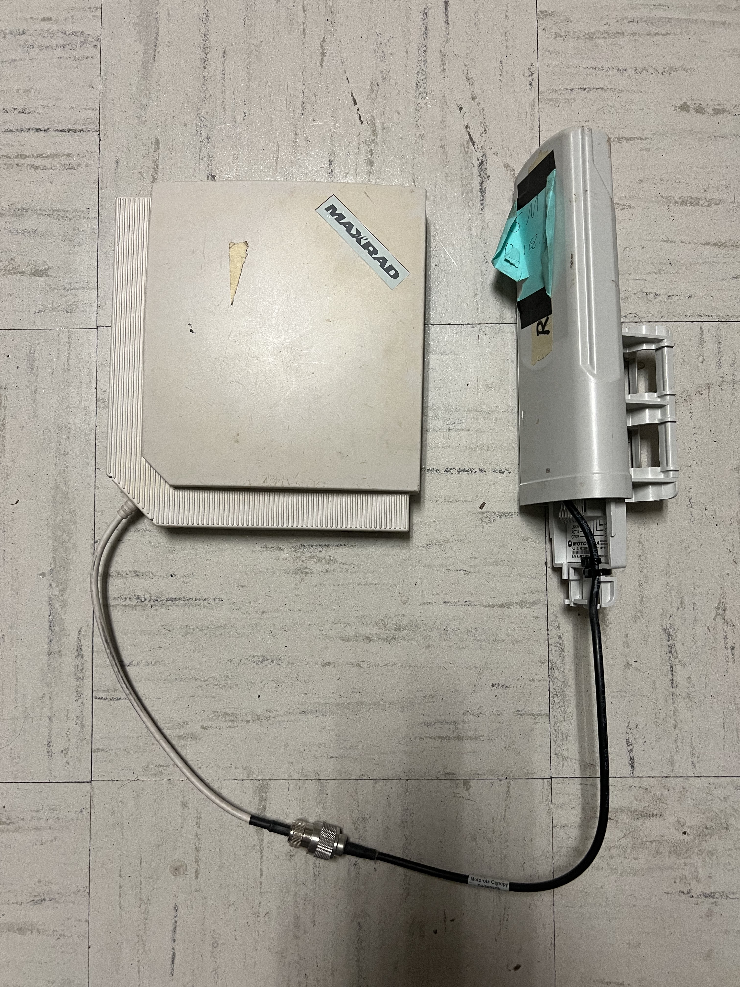
Experiment Device
KONA micro lite
RAK
ESP-32
Canopy
Notes:
Devices used for the experiments are shown in the slides
We used Kona micro lite which is used as indoor LoRaWAN gateway because it is consistent and reliable.
And for outdoor experiments, we used RAK gateway which is used as outdoor LoRaWAN gateway. Because it can receive data from far distance.
And we used ESP-32 as end nodes.
And we used a pair of canopies which is set in 906MHz as a jammer with additional 7dBm 900MHz directional antennas.
The reason why we use directional antennas is canopy is generally used with a directional antenna.

Slide 21
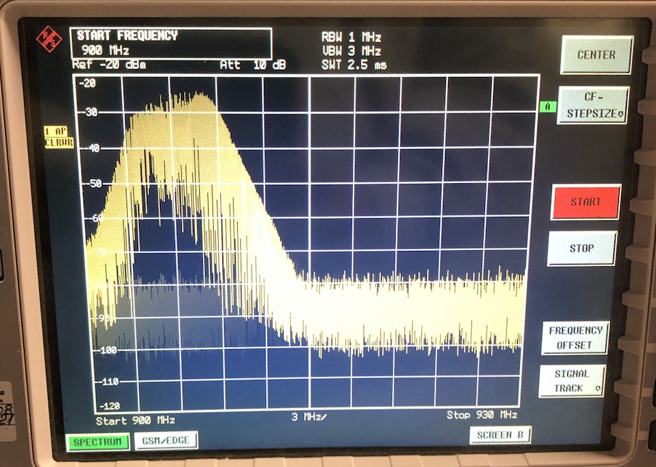
Why Only Jamming 906MHz?
LoRaWAN bandwidth:
902MHz ~ 928MHz
LoRaWAN Uplink Channel:
902MHz ~ 915MHz
Notes:
I think many people might be curious about why we are only jamming 906 MHz.
It is because although the LoRa is using 902 to 928 MHz, LoRa sends an uplink packet by just using 902 to 915 MHz.
It is also possible to jam full LoRa bandwidth, but for efficiency of the experiment, we decided to use just one pair of the canopy.

Slide 22
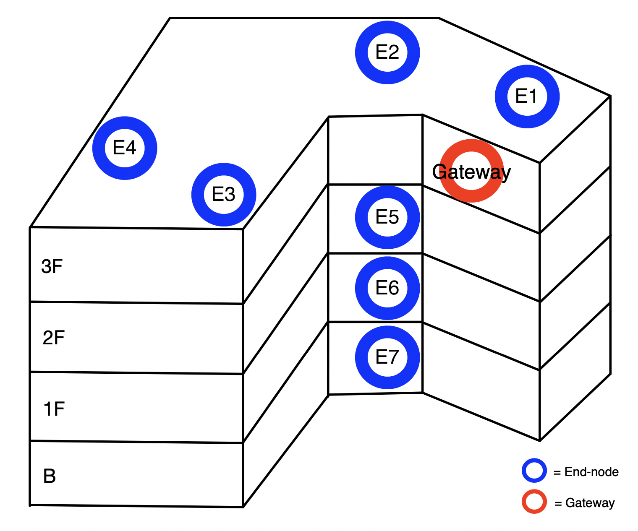
Indoor Experiment – End-nodes Placement
To Measure Jamming Performance According to the Distance
To See whether Jamming Effect Affected by Various Obstacles (Walls, Floors, Doors)
Notes:
Let’s see the placement of the end nodes in indoor experiment.
We wanted to measure jamming performance according to the distance of canopy and end-nodes.
And we wanted to check how obstacles affect the signal, not only walls but also the floors.
As you can see, we deployed end nodes at different locations in same floor and at same location in different floor.

Slide 23
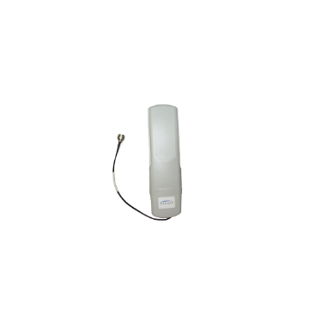
Intentional vs Unintentional
Close
Far
Intentional
Unintentional
Notes:
And we set the indoor experiment in two types. First one is intentional jamming and second one is unintentional jamming.
We defined the meaning of the intentional is the canopy devices are placed very closely.
Because canopy devices are generally used as wireless communication devices for a long distance.
Therefore, we defined unintentional is the canopy devices are placed far away from each other.
To simulate this environment, we placed the canopy devices close to each other for intentional jamming
And we placed the canopy devices as far as networking connection can be established from each other.

Slide 24
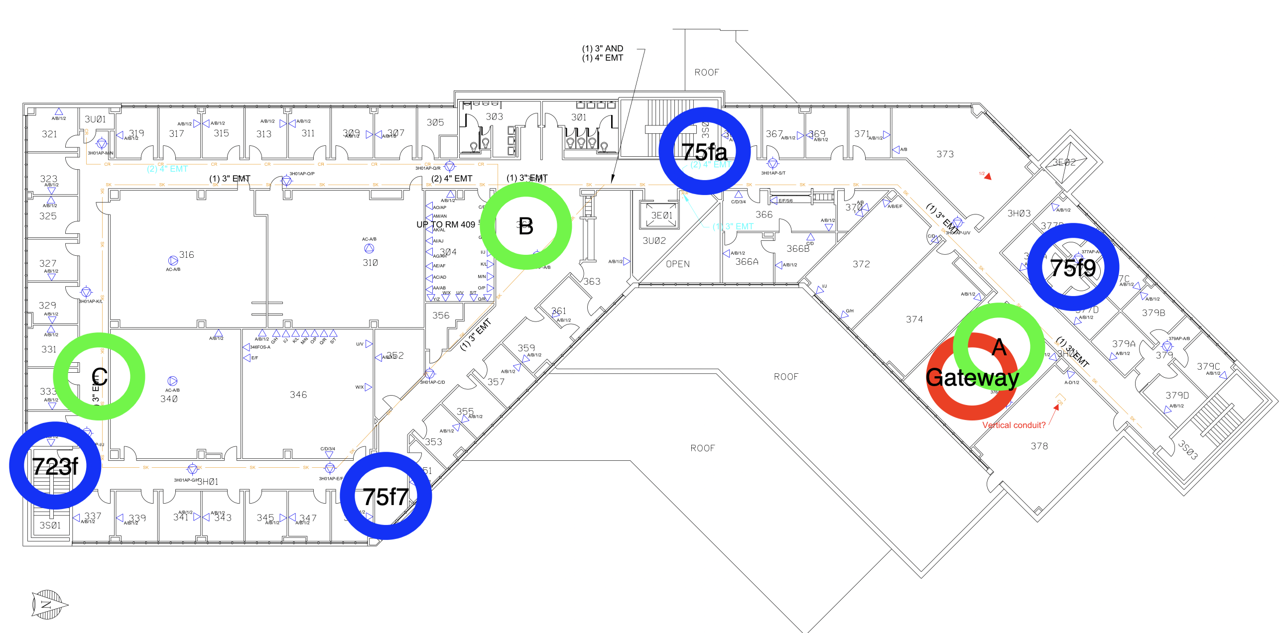
Indoor Experiment – Intentional
Notes:
And let’s see where canopy is located.
For intentional jamming we located at A, B and C zone.
Especially A is a close-in attack, it assumes that the attacker can access to the target gateway.
And the other two zones are designed to jam the LoRa signal if the location of the gateway is known.
The difference of the B and C is the distance from the gateway.
Because we want to measure the jamming performance according to the distance.

Slide 25
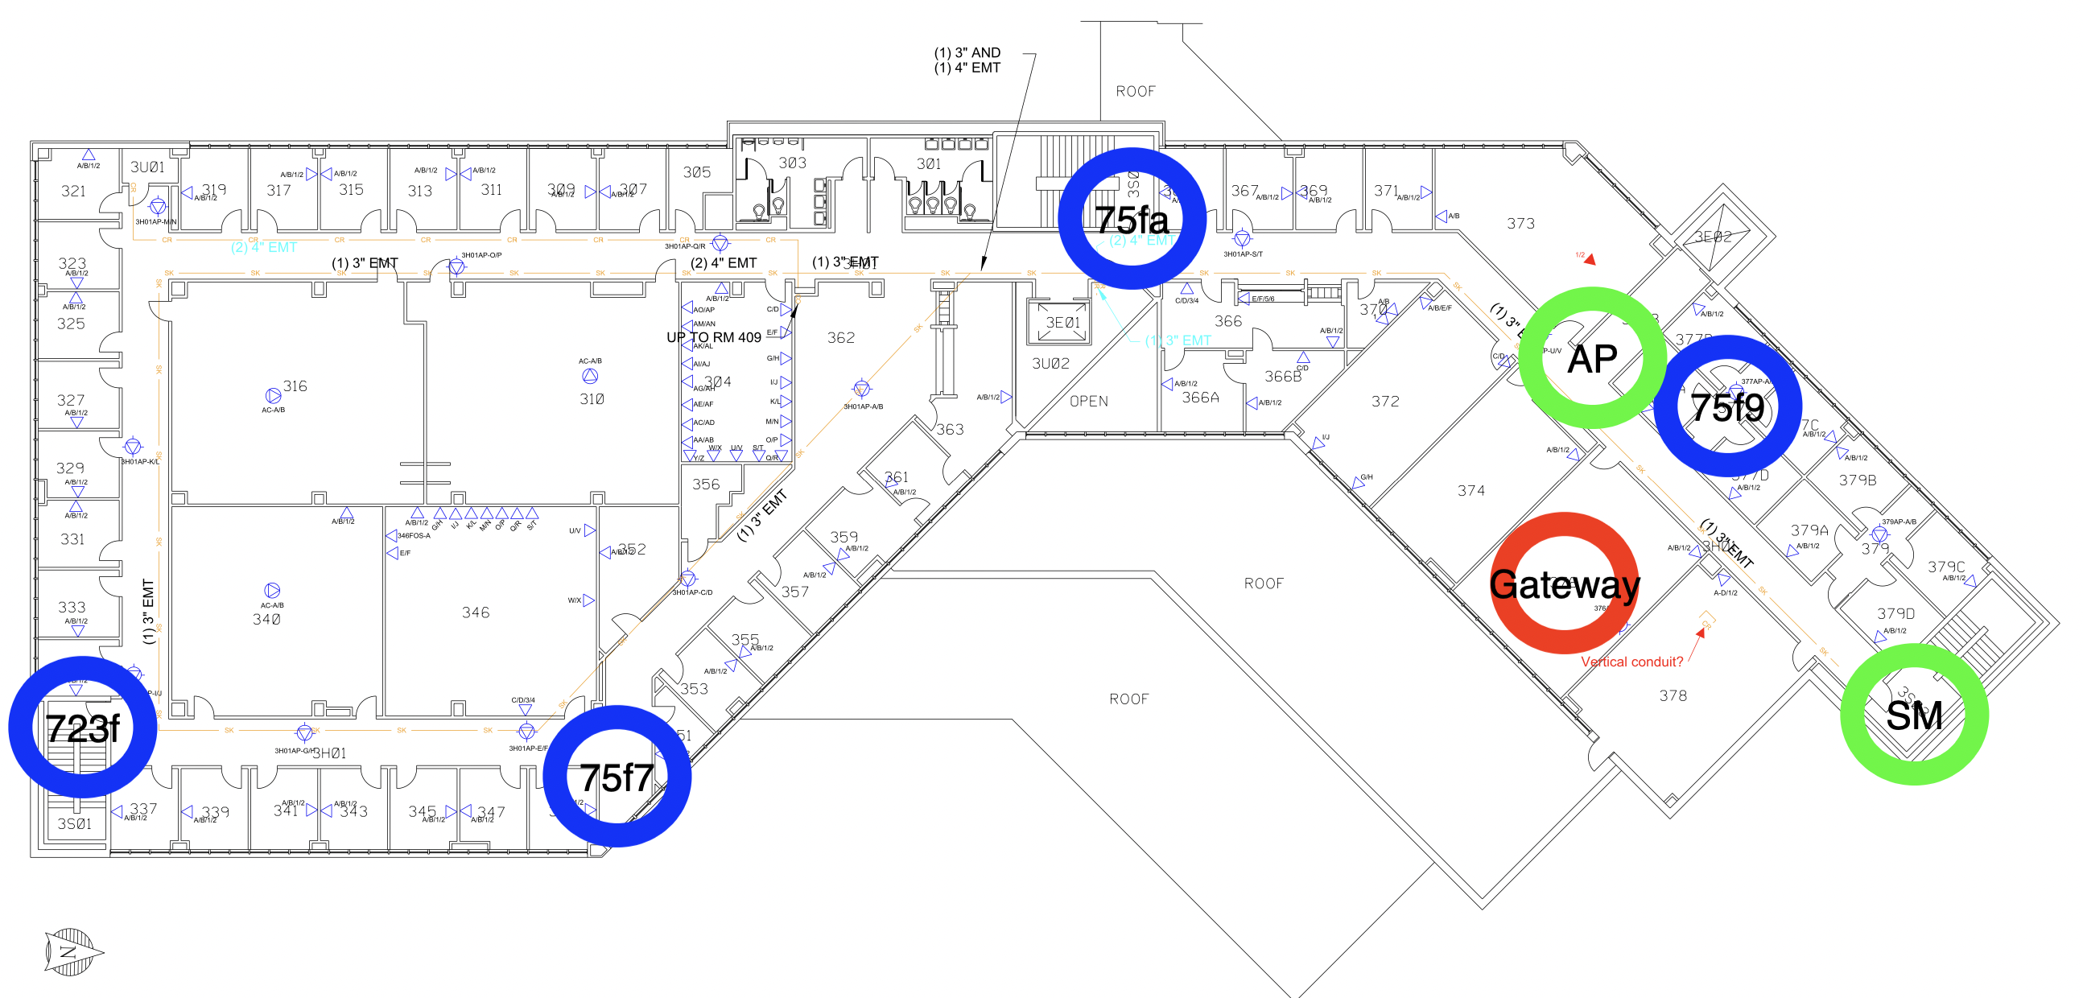
Indoor Experiment – Unintentional
Notes:
For unintentional jamming, Canopy Access Point was placed in front of the elevator and Canopy Subscriber Module was placed behind the wall.
The reason why we decided each place is it is the maximum distance of the canopy can make connection.
Because of the diffraction and reflections of the obstacles, canopy lost the connection when we move far away from here.

Slide 26
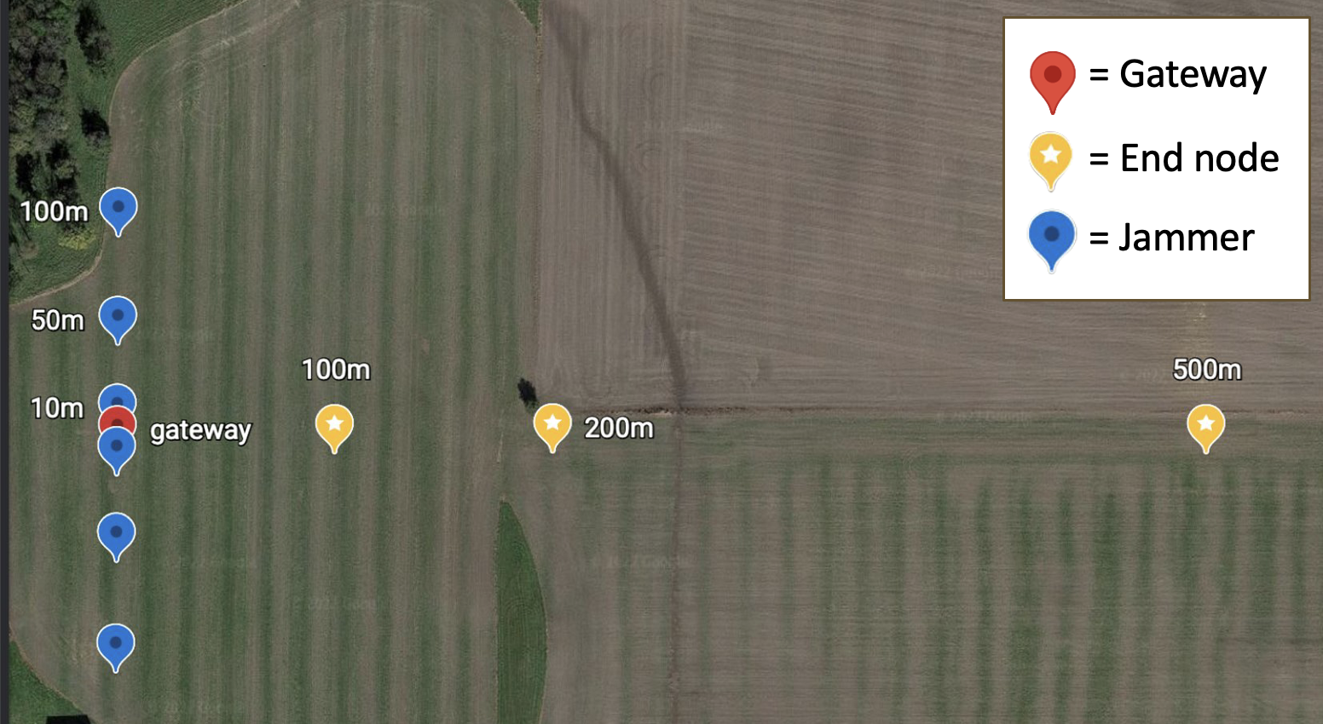
Outdoor Experiment
Notes:
Then I will talk about outdoor experiment architecture.
Outdoor experiments are conducted on the farm to simulate the agricultural environment.
We placed RAK gateway in the middle of the farm.
The three end nodes are placed horizontally according to the distances which are 100m, 200m, 500m to measure the difference of the jamming effect according to the distance.
And we move vertically away from the RAK gateway 10m, 50m, 100m with a canopy.

Slide 27
Experiment Outcome
Notes:
The result of these experiments will be presented by Junyoung.
Hello, I'm Junyoung Jang. First, I will explain the evaluation metrics we made, and then explain indoor and outdoor results.

Slide 28


Metrics
Calculate PDR (Packet Delivery Rate)
$$Average Time for sending 100 Packets Normally :100$$
$$=$$
$$Jamming Time :Number of Packets Should Be Received Normally$$
$∴PDR=\frac{Actual Number of Packets Received while Jamming}{Number of Packets Should be Received Normally}$
Notes:
The experiment measured the RSSI and PDR to test the effectiveness of jamming. The PDR can be calculated from the proportional expression shown in the slide. [(Average time of 100 packets sent normally) : 100 = (Time we spent on jamming) : (Number of packets received normally)]. To predict more accurate PDR, the amount of packets received without jamming was measured at first. To calculate the final assumed PDR, the number of packets received for 15 minutes was estimated and this expression was used. (PDR = (actual Number of packets received while jamming)/(Number of packets received normally).

Slide 29

Metrics
JE (Jamming Effect)
$JE=1 − \frac{PDR with Jamming}{PDR without Jamming}$
RSSI (Received Signal Strength Indication)
Measurement of the Power Present in a Received Radio Signal (Signal Strength)
-70dBm (Stronger Signal) > -110dBm (Weaker Signal)
(dBm = Decibel-Milliwatts)
Notes:
Jamming Effect was calculated by this expression (JE = 1 - PDR with jamming / PDR without jamming). The more influenced by Jamming, the bigger JE becomes. In summary, PDR represents data transmission capability, JE represents how much jamming effected, and RSSI represents how interrupted the signal was. Details will be explained in next slides. All the experiment datasets were organized in JSON files. We developed our own data-loader so that each experimental result could be automatically visualized.

Slide 30
Metrics
Summary
PDR(Packet Delivery Rate): Data Transmission Capability
Bigger = More Data Sent, 0 ~ 1
JE(Jamming Effect): How Jamming Affected LoRaWAN
Bigger = Jamming Affects More, 0 ~ 1
RSSI: how signals are interrupted
Smaller = Signals Were Disrupted
Notes:
Jamming Effect was calculated by this expression (JE = 1 - PDR with jamming / PDR without jamming). The more influenced by Jamming, the bigger JE becomes. In summary, PDR represents data transmission capability, JE represents how much jamming effected, and RSSI represents how interrupted the signal was. Details will be explained in next slides. All the experiment datasets were organized in JSON files. We developed our own data-loader so that each experimental result could be automatically visualized.

Slide 31
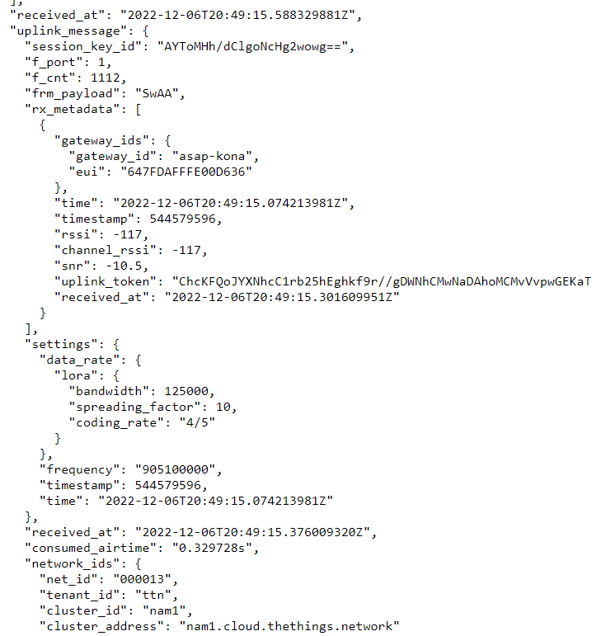
Metrics
JSON Files which recorded all packets received available
Use own Data-Loader to Parse / Analyze / Visualize JSON Files
Notes:
Jamming Effect was calculated by this expression (JE = 1 - PDR with jamming / PDR without jamming). The more influenced by Jamming, the bigger JE becomes. In summary, PDR represents data transmission capability, JE represents how much jamming effected, and RSSI represents how interrupted the signal was. Details will be explained in next slides. All the experiment datasets were organized in JSON files. We developed our own data-loader so that each experimental result could be automatically visualized.

Slide 32
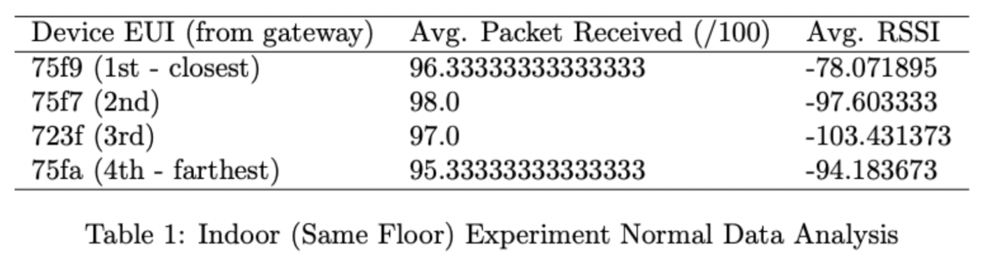
Indoor Experiment (Same Floor)
Before Jamming
Notes:
Indoor experiments are divided into intentional and unintentional point of view. Whether a packet was received or not was checked in the packet timeline (that our team created). Abnormal packets such as loss were removed.

Slide 33
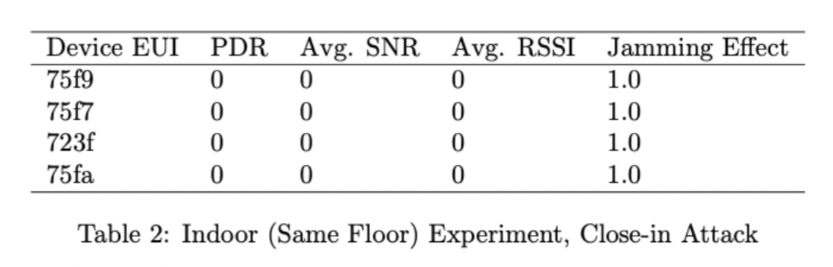
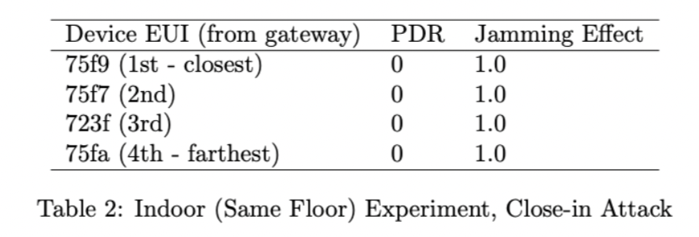
Indoor Experiment (Same Floor)
Close-in Attack
Notes:
First is the result of close in attack. Close in attack is a method of jamming at a close distance from the gateway and it is an intentional attack. As you can see in the following graph, any single packet was not received when close in attack was performed.

Slide 34
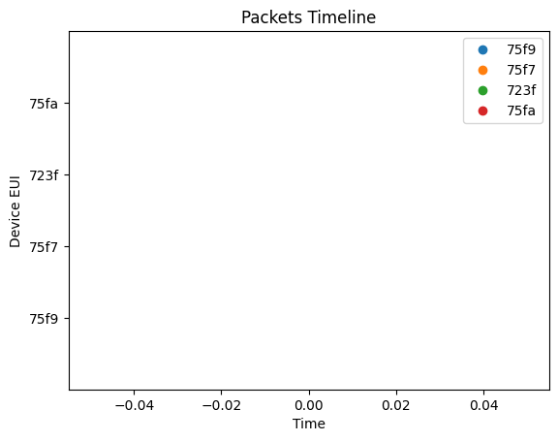
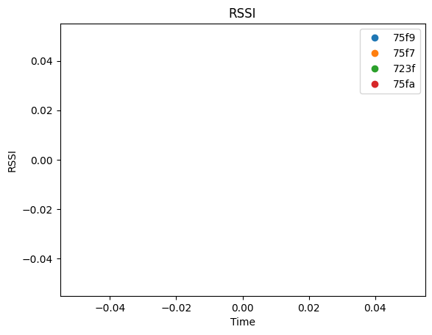
Indoor Experiment (Same Floor)
Close-in Attack
Notes:
First is the result of close in attack. Close in attack is a method of jamming at a close distance from the gateway and it is an intentional attack. As you can see in the following graph, any single packet was not received when close in attack was performed.

Slide 35
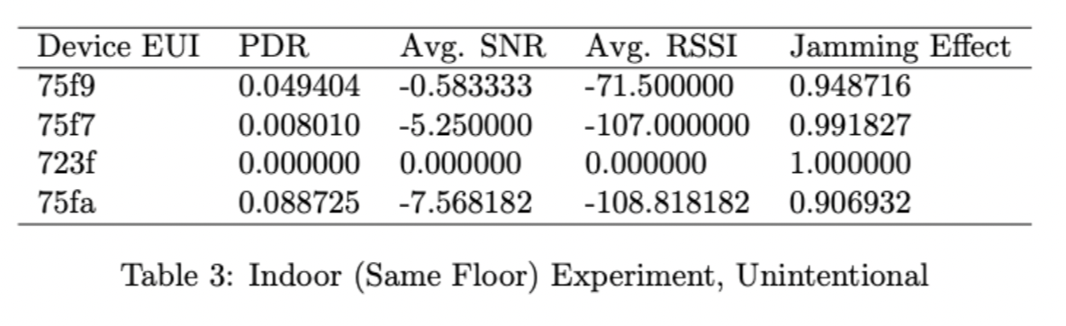
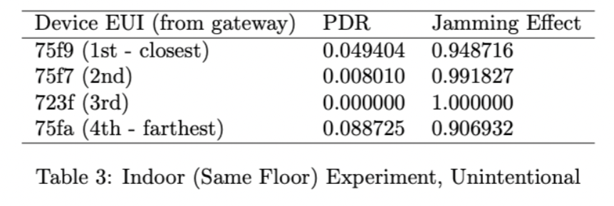
Indoor Experiment (Same Floor)
Unintentional Attack
Notes:
Next is the unintentional attack. We can see that the Jamming Effect is close to 1, which means the jamming was effective. The RSSI graph is showing that the closer ESP32 is, the stronger the signal is received.

Slide 36
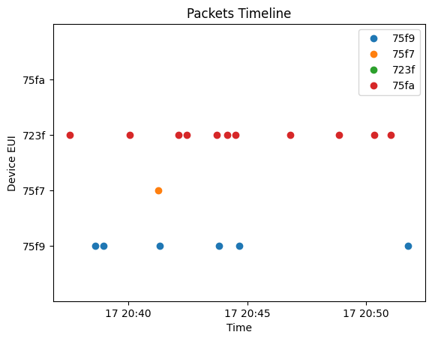
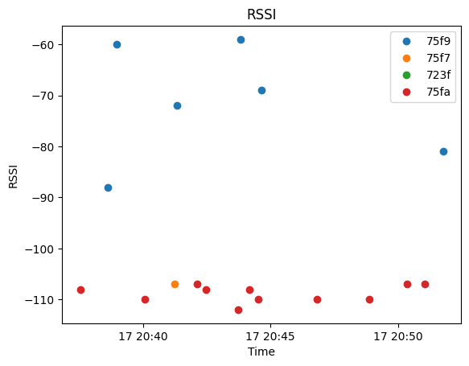
Indoor Experiment (Same Floor)
Unintentional Attack
Notes:
Next is the unintentional close distance attack. We can see that the Jamming Effect is close to 1, which means the jamming was effective. The RSSI graph is showing that the closer ESP32 is, the stronger the signal is received.

Slide 37
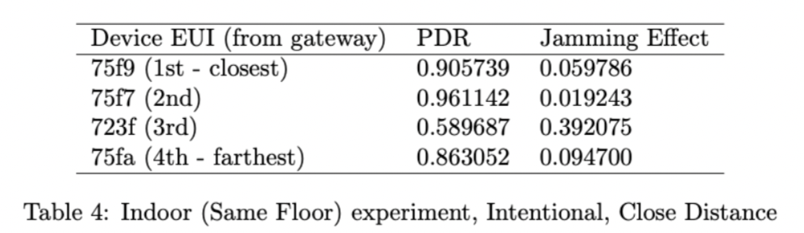
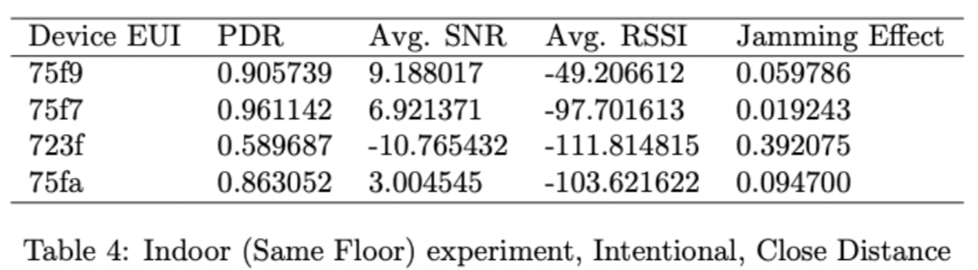
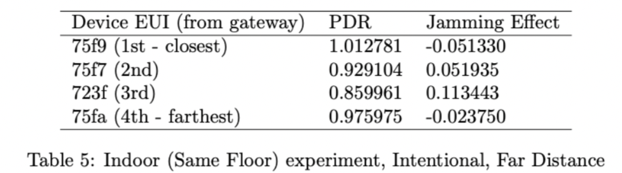
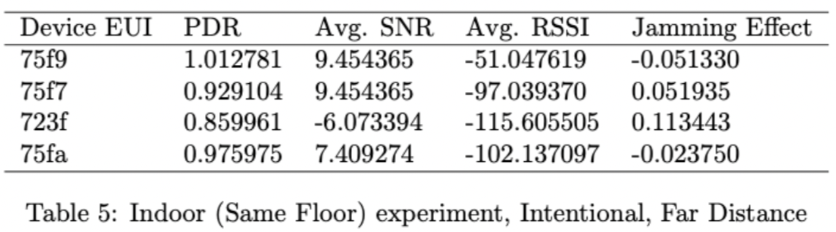
Indoor Experiment (Same Floor)
Intentional Close Distance attack
Intentional Far Distance attack
Notes:
The following are intentional close distance and intentional far distance attacks. If ESP32 are placed on the same floor, Jamming Effect was low, which means jamming did not work properly. RSSI is showing the same tendency as the experiment before.

Slide 38
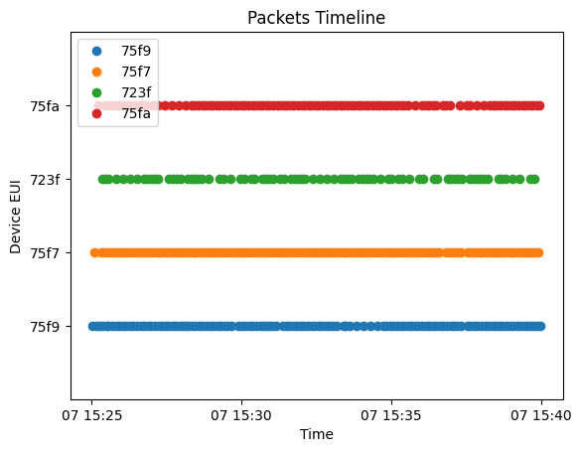
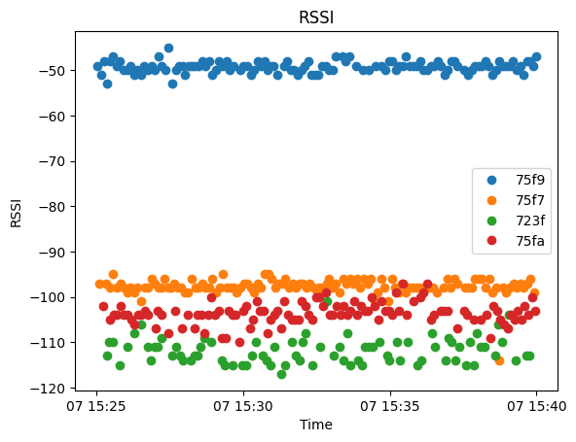
Indoor Experiment (Same Floor)
Intentional Close Distance attack
Notes:
The following are intentional close distance and intentional far distance attacks. If ESP32 are placed on the same floor, Jamming Effect was low, which means jamming did not work properly. RSSI is showing the same tendency as the experiment before.

Slide 39
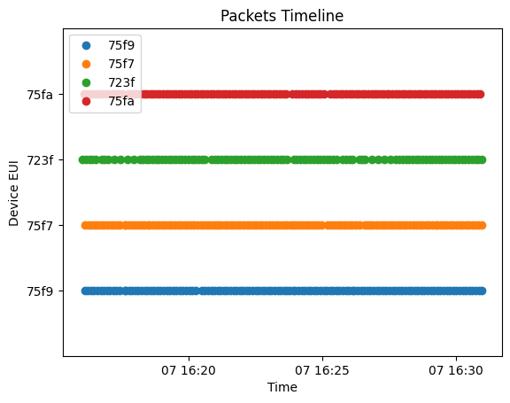
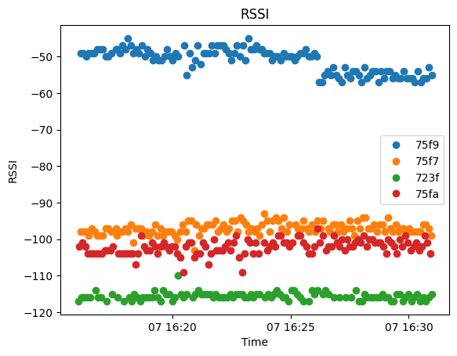
Indoor Experiment (Same Floor)
Intentional Far Distance Attack
Notes:
The following are intentional close distance and intentional far distance attacks. If ESP32 are placed on the same floor, Jamming Effect was low, which means jamming did not work properly. RSSI is showing the same tendency as the experiment before.

Slide 40
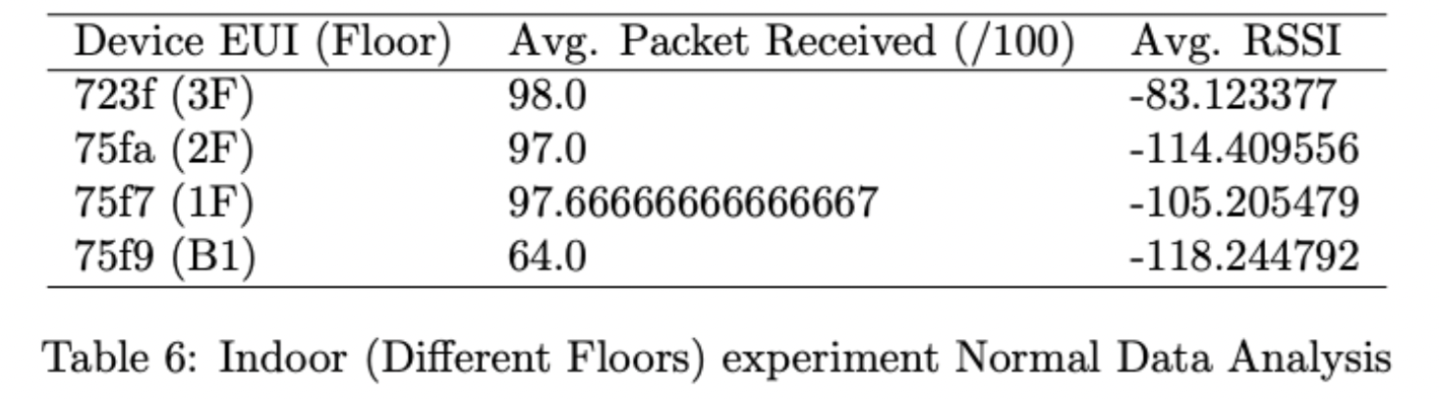
Indoor Experiment (Upstairs and downstairs experiment)
Before Jamming
Notes:
Now, it is Upstairs and downstairs experiment that ESP32s were distributed on different floors.

Slide 41
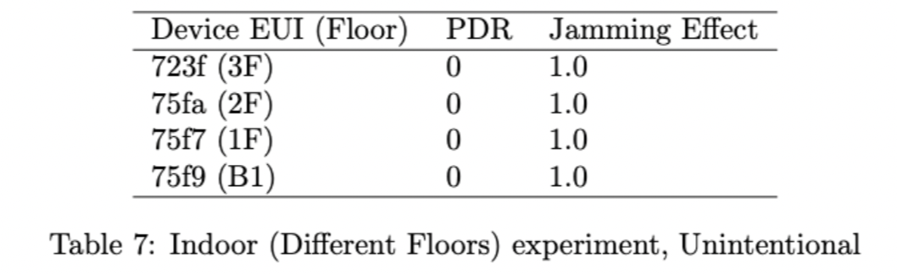
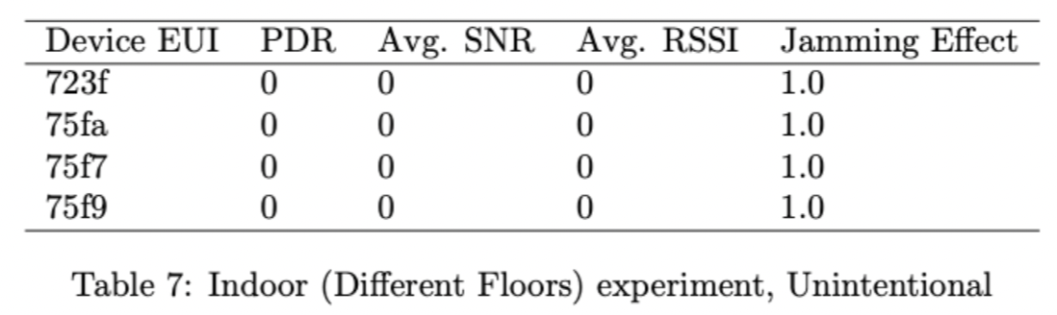
Indoor Experiment (Upstairs and downstairs experiment)
Unintentional Attack
Notes:
(Unintentional close distance) shows perfect performance. JE is 1, which means any single was not received.

Slide 42


Indoor Experiment (Upstairs and downstairs experiment)
Unintentional Attack
Notes:
(Unintentional close distance) shows perfect performance. JE is 1, which means any single was not received.

Slide 43
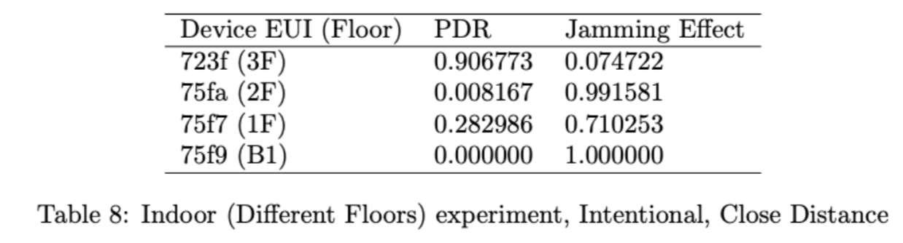
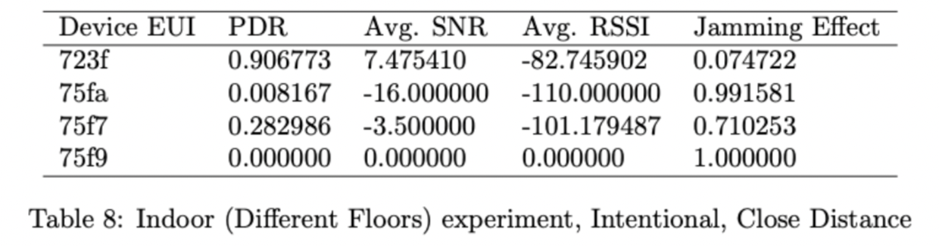
Indoor Experiment (Upstairs and downstairs experiment)
Intentional Close Distance attack
Notes:
(Intentional close distance) shows insufficient performance compared to the test which had enough distance between canopy devices. But it showed better jamming performance compared to the test that ESP32s were placed on the same floor. End nodes with further distance tended to be more affected by jamming.

Slide 44
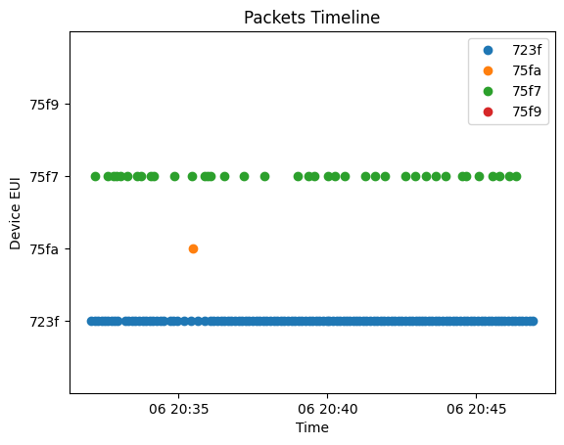
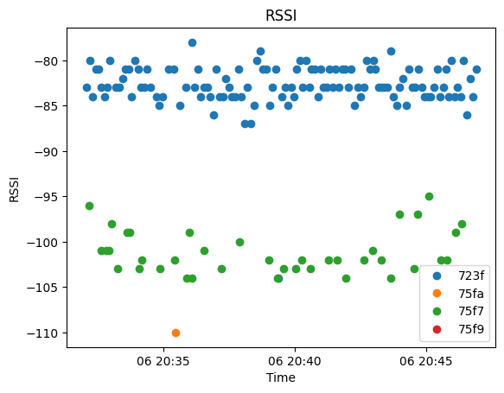
Indoor Experiment (Upstairs and downstairs experiment)
Intentional Close Distance attack
Notes:
(Intentional close distance) shows insufficient performance compared to the test which had enough distance between canopy devices. But it showed better jamming performance compared to the test that ESP32s were placed on the same floor. End nodes with further distance tended to be more affected by jamming.

Slide 45
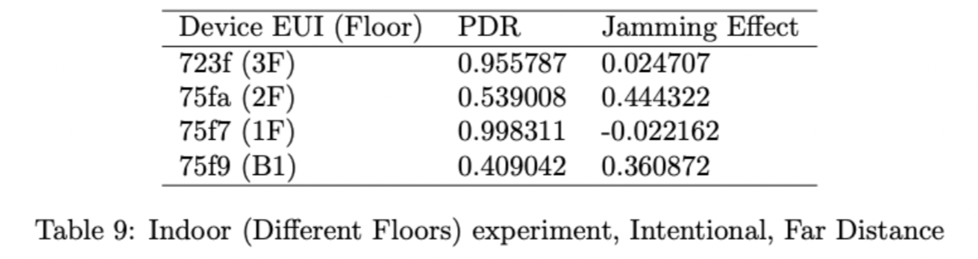
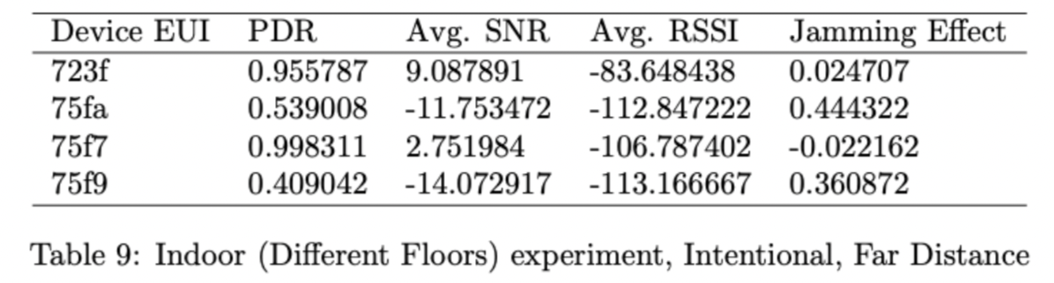
Indoor Experiment (Upstairs and downstairs experiment)
Intentional Far Distance Attack
Notes:
Although the impact of jamming existed, (Intentional Far Distance) did not show perfect performance. However, considering that indoor LoRaWAN is used in critical places that no single error is allowed, such as a hospital, these kinds of packet loss will cause a significant impact. As you can see from the RSSI graph, the first floor could send more packets than the second floor. This means that in indoor environment, not only distance but reflection and scattering matter because there are many obstacles, such as walls or doors.

Slide 46


Indoor Experiment (Upstairs and downstairs experiment)
Intentional Far Distance Attack
Notes:
Although the impact of jamming existed, (Intentional Far Distance) did not show perfect performance. However, considering that indoor LoRaWAN is used in critical places that no single error is allowed, such as a hospital, these kinds of packet loss will cause a significant impact. As you can see from the RSSI graph, the first floor could send more packets than the second floor. This means that in indoor environment, not only distance but reflection and scattering matter because there are many obstacles, such as walls or doors.

Slide 47

Outdoor Experiment
Before Jamming
Notes:
Before jamming data of the outdoor experiment are as follows. There were no obstacles compared to the indoor environment, so you can see that it works well even at a longer distance.

Slide 48




Outdoor Experiment
Unintentional 10m
Notes:
The unintentional 10 meter graph is shown below. You can see that only two packets had been received. On the unintentional 50 meter graph shown below, no single packet was received, and the same things happened for Unintentional 100 meter. Overall, we proved outdoor jamming performed very well. All the signals sent from 100m 200m 500m were jammed.

Slide 49



Outdoor Experiment
Unintentional 50m
Notes:
The unintentional 10 meter graph is shown below. You can see that only two packets had been received. On the unintentional 50 meter graph shown below, no single packet was received, and the same things happened for Unintentional 100 meter. Overall, we proved outdoor jamming performed very well. All the signals sent from 100m 200m 500m were jammed.

Slide 50

Outdoor Experiment
Unintentional 100m
Notes:
The unintentional 10 meter graph is shown below. You can see that only two packets had been received. On the unintentional 50 meter graph shown below, no single packet was received, and the same things happened for Unintentional 100 meter. Overall, we proved outdoor jamming performed very well. All the signals sent from 100m 200m 500m were jammed.

Slide 51
Conclusion
Security vulnerability on physical layer of LoRaWAN
Using legacy of 900 MHz devices
Intended and Unintended situation
Fully reflected the actual environment
Reconsidered security vulnerability of LoRaWAN
Metrics for accurate performance evaluation
Notes:
The purpose of our work was to examine Jamming, a security vulnerability in the physical layer of LoRaWAN, in both intentional and unintentional aspects. At this time, we proved that jamming could be conducted using a legacy 900 MHz device, which is cost efficient. Experiments have shown that Canopy can jam the frequency of LoRaWAN even in unintended situations because it is used for general communication. These experiments were done in indoor and outdoor environments that fully reflected the actual environment of the hospitals and farms that might use LoRaWAN. We have shown a meaningful jamming effect, which suggests that we should reconsider the security vulnerability of LoRaWAN. In addition, the metric was presented for more accurate performance evaluation during the research, which could show the effect of jamming. In conclusion, this research successfully demonstrates the security vulnerability of the LoRaWAN on the physical layer.

Slide 52
Reference
[1] IoT Analytics, "Global IoT market size", iot-analytics.com [Online]. Available: https://iot-analytics.com/iot-market-size/. [Accessed: 10-Dec-2022].
[2] ALLION, "Wireless Technologies in IoT", allion.com [Online]. Available: https://www.allion.com/iot-lpwan/. [Accessed: 10-Dec-2022].
[3] HELTEC Automation, "WiFi LoRa 32 (V2.1) Phaseout", heltec.org [Online]. Available: https://heltec.org/project/wifi-lora-32/. [Accessed: 10-Dec-2022].
[4] intellias, "Use cases of LoRaWAN smart city", intellias.com [Online]. Available: https://intellias.com/why-lora-is-the-best-option-for-smart-city-and-smart-building-applications/. [Accessed: 10-Dec-2022].
[5] IoT Analytics, "IoT Enterprise Spending", iot-analytics.com [Online]. Available: https://iot-analytics.com/2021-global-iot-spending-grow-24-percent/. [Accessed: 10-Dec-2022].

Slide 53
Q & A
Team 454P
2022 K-SW square final-presentation

Slide 54
Thank you
Team 454P
2022 K-SW square final-presentation

Slide 55
Use cases of LoRaWAN
Figure 3: Wi-Fi LoRa 32 [3]
Figure 4: LoRaWAN use cases within a smart city [4]
Coverage , Battery life, Cost effective and Data rate

